Slide 1

LINUX ESSENTIALS COURSE
Vital Tech
Myanmar
Present By Vital Tech Myanmar
Vital Tech Myanmar IT Solution & Training. All Right Reserved © 2023

Slide 2
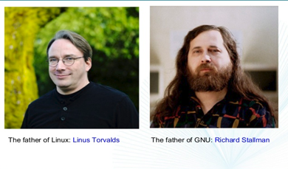
What is Linux?
Vital Tech
Myanmar
Linux is a free and open source operating system.
At it’s core, the linux operating system is derived from the Unix OS.
Unix was created in the 1960s by Dennis Ritchie and Ken Thompson, both of them also invented the C Programming Language.
Linux was initially named GNU and was developed by Richard Stallman
Linux was the name of the kernel created in 1991 by Linus Torvalds, a student at the University of Helsinki
Linus Torvalds had wanted to call his invention "Freax" i.e., Free, Freak + x as an allusion to Unix. In this project his partner Mr. A.L. Torvalds did not think it's a good name, So they finally decided named their project name as "Linux".
Vital Tech Myanmar IT Solution & Training. All Right Reserved © 2023

Slide 3

Vital Tech
Myanmar
Linux Distribution
Linux OS has multiple distributions (called distros) that are derived from it’s initial development.
Most of the are FREE and offer full functionality:
Debian
Ubuntu
RedHat
Rocky Linux (Released April 30, 2021)
CentOS
OpenSUSE
For more info about various types of Linux: https://distrowatch.com/
Vital Tech Myanmar IT Solution & Training. All Right Reserved © 2023

Slide 4
Vital Tech
Myanmar
Architecture of Linux
Kernel:
Linux is not a operating system, Linux is kernel.
The kernel is the heart of the operating system.
It interacts with hardware and most of the tasks like memory management, task scheduling and the file management
Shell:
The shell is the utility that processes your requests
When you type in a command at your terminal, the shell interprets the command and calls the program that you want.
The shell uses standard syntax for all commands.
C Shell (csh), Bourne Again Shell(Bash) are most famous shells which available with most of the Unix variants.
Bash is the default for Linux
Vital Tech Myanmar IT Solution & Training. All Right Reserved © 2023

Slide 5
Vital Tech
Myanmar
Advantages and Disadvantages of Linux
Advantages
It’s free and open source
Linux is portable hardware platform
Requires minimal hardware configuration
Linux continue work well even when the hard disk is almost full
Disadvantages
Text Interface is not as user-friendly as windows
Less Commercial software available
More difficult to setup
There are far too many distro
Vital Tech Myanmar IT Solution & Training. All Right Reserved © 2023

Slide 6
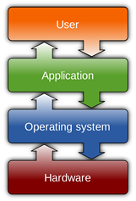
Vital Tech
Myanmar
What is Operating System?
An Operating System is a system software that manage computer hardware and software resources and provides common services for computer programs.
Manage processor resources to handle input, output and processing tasks.
Manage memory by allocating space for all the programs and data that are in use during a computing session
Keep track of storage resources so that files and programs can be found and manipulated.
Ensure that input and output proceed in an orderly manner by communicating with peripheral devices.
Establish basic elements of the user interfaces such as the appearance of the desktop, menus, and toolbars.
Vital Tech Myanmar IT Solution & Training. All Right Reserved © 2023

Slide 7
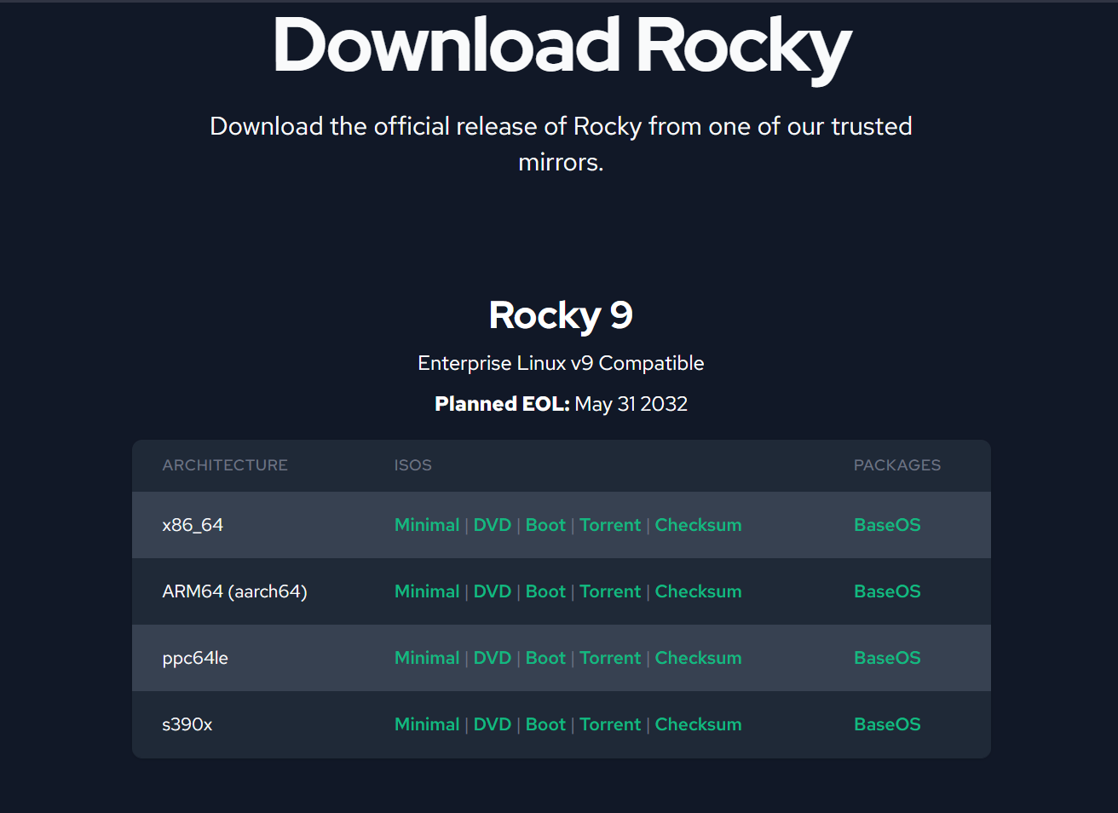
Vital Tech
Myanmar
Rocky Linux Installation
Prerequisites
HDD minimum: 20GB
RAM minimum: 2GB (Recommended 4GB)
System Type: 64-bit x86 System
Installation kit: Bootable DVD/USB/.iso
Download Rocky Linux
Rocky Linux's official site provides a direct download link
for the iso file.
https://rockylinux.org/download/
Vital Tech Myanmar IT Solution & Training. All Right Reserved © 2023

Slide 8
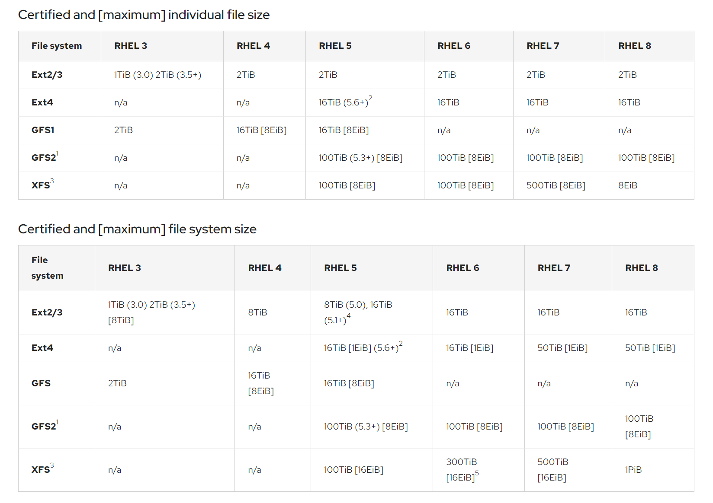
Vital Tech
Myanmar
Partition File System
Vital Tech Myanmar IT Solution & Training. All Right Reserved © 2023

Slide 9
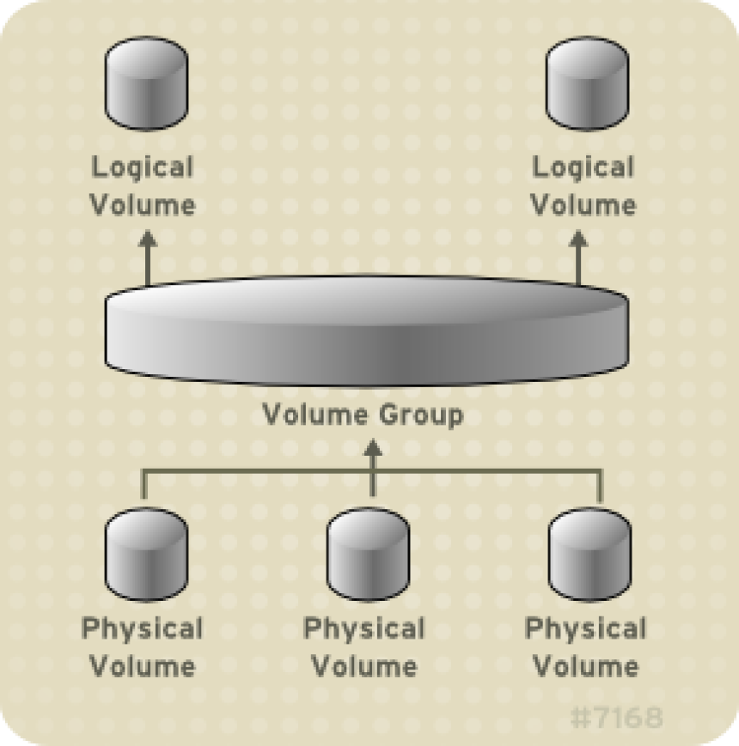
Vital Tech
Myanmar
Logical Volume Manager (LVM)
Vital Tech Myanmar IT Solution & Training. All Right Reserved © 2023

Slide 10
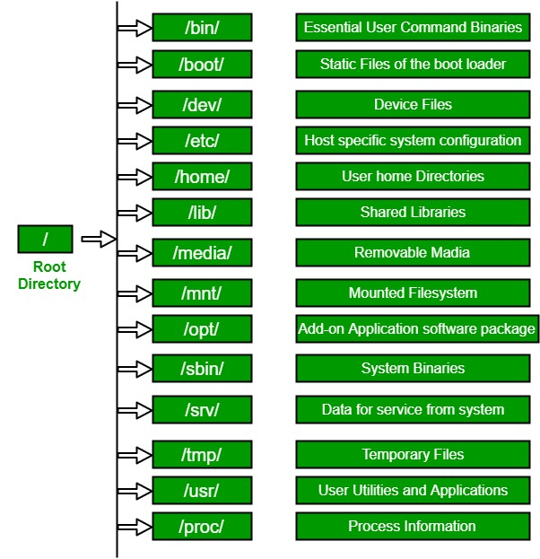
Vital Tech
Myanmar
Linux File System Hierarchy
In Windows we call them folders, in Linux the term used is directory/directories.
Vital Tech Myanmar IT Solution & Training. All Right Reserved © 2023

Slide 11
Vital Tech
Myanmar
Linux File System Hierarchy
The equivalent of the “C:\” partition in Windows is referred in Linux as “/” – also called “root” directory, or “slash”.
The Linux file system has the root directory at the top of the directory tree.
The Following list of directories are subdirectories of the root directory. This directory is denoted by the / (pronounced “slash”) symbol.
/bin
Contain executable program such as ls (“dir” in Windows) and cp (“copy” in Windows). These programs are designed to make the system usable.
/etc
Contains system configuration files which are local to the machine. Programs store configuration files in the directory and these files are referenced when programs are run.
/home
Contains user account directories. Each user created by the system administrator will have a subdirectory under /home with the name of the accounts. This is default behaviour of Linux System. E.g. User account for Carter is created, her home directory will be located in /home/carter.
Vital Tech Myanmar IT Solution & Training. All Right Reserved © 2023

Slide 12
Vital Tech
Myanmar
Linux File System Hierarchy
/mnt
Used for mounting temporary filesystems. When mounting a CD-ROM for instance, the standard mount point location is /mnt/cdrom.
/opt
Used for storing random data that has no other logical destination.
/proc
Provides information about running process and the kernel. A directory is provided for each running process. Useful system information such as the amount of Random Access Memory (RAM) available on the system as well as Central Processing Unit(CPU) speed in Megahertz (MHz) can be found within the /proc directory.
/root
This is home directory for the super user (root). This directory is not viewable from user accounts. The /root directory usually contains system administration files.
/sbin
Similar to /bin, this directory contains executable programs needed to boot the system, however the programs within /sbin are executed by the root user.
Vital Tech Myanmar IT Solution & Training. All Right Reserved © 2023

Slide 13
Vital Tech
Myanmar
Linux File System Hierarchy
/tmp
This directory is used for temporary storages spaces. Files within this directory are often cleaned out either at boot time or by a regular process
/usr
Used to store applications. When installing an application on a Debian GNU/Linux machine, the typical path to install would be /usr/local. You will notice the directory structure within /usr appears similar to the root directory structure.
/var
This directory contains files of variable file storage. File in /var are dynamic and are constantly being written to or changed. This the directory where websites are usually stored in.
/boot
The files necessary for the system to boot.
/dev
All device drivers are the files that your there’s a file in the /dev directory for your particular make and model of monitor, and all of your Linux computer’s communication with the monitor go through that file.
/lib
System libraries. Libraries are just bunches of programming code that the programs on your system use to get things done.
Vital Tech Myanmar IT Solution & Training. All Right Reserved © 2023

Slide 14
Vital Tech
Myanmar
File System
Windows uses letters of the alphabet to represent different devices and different hard disk partitions. Under Windows, you need to know what volume (C:, D:, …) a file resides on to select it, the file’s physical location is part of it’s name.
In Linux all directories are attached to the root directory, which is identified by a forward-slash, “/”. – root.
For example, below are some second-level directories:
# - shell command.
# fdisk –l /*list partitions*/
#/dev/sda1
/dev device
/sda1 or /hda1
sd – SATA /*SATA – tech to read/write data*/
hd – IDE
a
Vital Tech Myanmar IT Solution & Training. All Right Reserved © 2023

Slide 15
Vital Tech
Myanmar
File System
Sd ..a/b/c/d…1/2/3…
a – primary master
b - primary slave
c - secondary master
d - secondary slave
1/2/3 … - first/second/third partition
# fdisk /dev/sda /* ‘m’ for help*/
(if type “l” it will list all available file sys with their Id e.g. Windows - 7and Linux – 83)
/dev/sda1 – sys reserve
/dev/sda2 – is C:\
(Windows makes 2 partition: 100MB (From 100GB) for sys reserve and remaining C:\(100GB))
Vital Tech Myanmar IT Solution & Training. All Right Reserved © 2023

Slide 16
Vital Tech
Myanmar
Linux Help (Man)
You can keyword search for commands
For instance, what commands show a calendar?
$ man –k calendar
cal (1) - displays a calendar
cal (1p) – print a calendar
Difftime (3p) – compute the difference
Linux Help (Info)
A program for reading documentation, sometimes a replacement for manual pages
Example : info ls
Vital Tech Myanmar IT Solution & Training. All Right Reserved © 2023

Slide 17
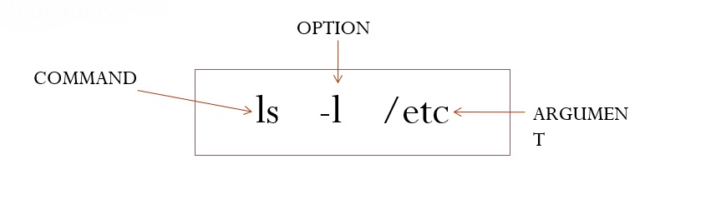
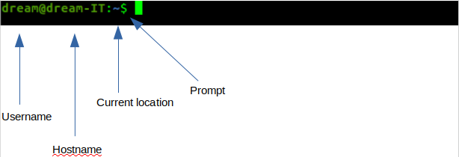
Vital Tech
Myanmar
Terminal Overview
(How to do)
(What to do)
(Target)
Vital Tech Myanmar IT Solution & Training. All Right Reserved © 2023

Slide 18
Vital Tech
Myanmar
Linux File Paths
Two type of file paths – Absolute file path and Relative file path.
Absolute file path
An absolute path is defined as the specifying the location of a file or directory from the root directory( / ).
Start at the root directory ( / ) and work down.
Write a slash ( / ) after every directory name (last one is optional)
Eg. cat /etc/passwd
vim /etc/sysconfig/network-scripts/ifcfg-eth0
ls /home/carter/Desktop/
Vital Tech Myanmar IT Solution & Training. All Right Reserved © 2023

Slide 19
Vital Tech
Myanmar
Linux File Paths
Relative file path
Relative path is defined as the path related to the present working directly(pwd). It start at your current directory and never starts with a / .
A shortcut in the relative pathname – that uses either the current or parent directory as reference and specifies the path relative to it . A relative path-name uses one of these cryptic symbols:
. (a single dot) – this represents the current directory.
.. (two dots) – this represents the parent directory.
Vital Tech Myanmar IT Solution & Training. All Right Reserved © 2023

Slide 20
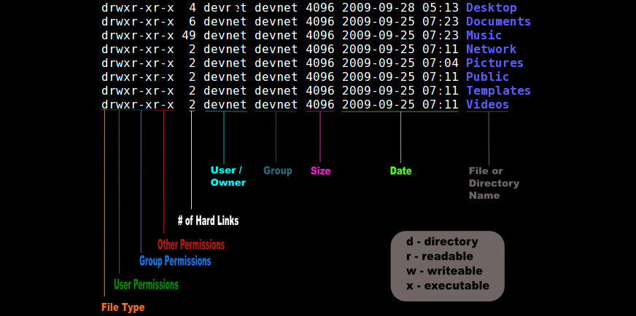
Vital Tech
Myanmar
Linux File/Directory Properties
Type ls -l in Terminal
Vital Tech Myanmar IT Solution & Training. All Right Reserved © 2023

Slide 21
Vital Tech
Myanmar
Linux Basic Command Part-1
cd (change the shell working directory
ls (list of file/directories)
pwd (Print Working Directory)
mkdir
touch
date (date and time)
cal (calendar)
cp
mv
echo
head (first 10 lines of each file)
tail (last 10 lines of each file)
cat (rad standard input)
more (scroll up and down)
less (up and down)
uname
df (Hard Disk Information)
Vital Tech Myanmar IT Solution & Training. All Right Reserved © 2023

Slide 22
Vital Tech
Myanmar
Linux Basic Command Part-2
rmdir(delete an empty directory), rm(delete a file or directory)
top
ps
kill -9 process id
Ifconfig, ping, traceroute, dig (like nslookup)
whatis, whereis
free
lsblk
du –h
su
which (like locate)
uptime (check uptime of machine)
lastlog (check the last logging user and time)
history (display last commands in history)
nano, vi
Vital Tech Myanmar IT Solution & Training. All Right Reserved © 2023

Slide 23
Vital Tech
Myanmar
Text Editor (VI)
Editors are used for adding, modifying and / or deleting text.
The different editors used
Windows (Notepad)
Linux
1.CLI Based (vi, nano)
2.GUI Based (gedit)
Vi editors is a screen oriented text editors written by Bill Joy in 1976.
This is the most commonly used editor for editing files in linux.
Vi Editor Modes
Command mode
Insert Mode
Ex Mode
Vital Tech Myanmar IT Solution & Training. All Right Reserved © 2023

Slide 24
Vital Tech
Myanmar
Insert mode
i - Inserts the text at the current cursor position.
l - Inserts the text in beginning of line.
a - Adds the text after the current cursor position.
A - Adds the text at the end of the line.
o - Insert the text one line below current cursor point.
O - Insert the text one line above current cursor point.
Vital Tech Myanmar IT Solution & Training. All Right Reserved © 2023

Slide 25
Vital Tech
Myanmar
Command mode
dd - Delete a line.
3dd - Delete ‘3’ lines.
yy - Copies a lines.
3yy - Copies “3” lines.
p - Put (Paste the deleted or copied text.)
u - Undo (you can undo 1000 times)
Vital Tech Myanmar IT Solution & Training. All Right Reserved © 2023

Slide 26
Vital Tech
Myanmar
Ex mode
:q - Quit without saving.
:w - Write (save).
:wq - Save and quit.
:se nu - Set line numbers.
:se nonu - remove line numbers.
:88 - This cursor goes to line 84.
Vital Tech Myanmar IT Solution & Training. All Right Reserved © 2023

Slide 27
Vital Tech
Myanmar
Tar Command
The Linux ‘tar’ stands for tape archive, is used to create archive and extract the archive files. Tar command in Linux is one of the important command which provides archiving functionality in Linux. We can use Linux tar command to create compressed or uncompressed archives files and also maintain and modify them.
# tar <option> <archive name> <source file or dir>
Options
-c = create an archive
-t = display or lists files in archived file
-x = extract an archive
-f = creates archive with given filename
-v = display Verbose Information
-z = zip, tells tar command that creates tar file using gzip
-r = update or add file or directory in already existed .tar file
-j = filter archive tar file using tbzip
Vital Tech Myanmar IT Solution & Training. All Right Reserved © 2023

Slide 28
Vital Tech
Myanmar
Local User and Group Management
Vital Tech Myanmar IT Solution & Training. All Right Reserved © 2023

Slide 29
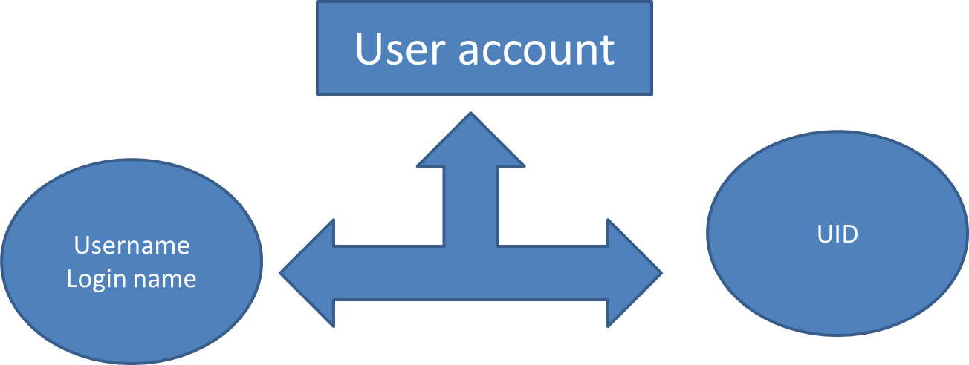
Vital Tech
Myanmar
User Accounts
A user account is a systematic approach to track and monitor the usage of system resources. Each user account contains two unique identifiers; username and UID.
When a user account is created, its username is mapped to a unique UID.
Vital Tech Myanmar IT Solution & Training. All Right Reserved © 2023

Slide 30
Vital Tech
Myanmar
Types of user accounts
There are three types of user in linux –
Super User (root)
Normal User
System User (service user account)
Super User (UID 0)
Super User is the main user account in Linux System. It is automatically created during the installation. It has the highest privilege in system. It can do any administrative work and can access any service.
Normal User (1001 – 60000)
Normal User is the one of the user account is created automatically. After the installation, we can create as many normal user accounts as we need. This account has moderate privilege.
System User (1 – 999)
System User are created by installation packages when they are installed. These accounts are used by services to run processes and execute functions.
Vital Tech Myanmar IT Solution & Training. All Right Reserved © 2023

Slide 31
Vital Tech
Myanmar
User and Group Management Command
#id
The id command is used to show information about current logged-in user.
#id <username>
Basic information about another user can also be requested by passing in the username of that user as the first argument to the id command.
#useradd <username>
#userdel -r <username>
The “r” option is important for user delete
#usermod <option> <username>
Usermod command is used to for user modify. You can check option with this command “usermod --help”
Vital Tech Myanmar IT Solution & Training. All Right Reserved © 2023

Slide 32
Vital Tech
Myanmar
User and Group Management Command
#passwd
Current user password change
#passwd <username>
Other user password change but root user only can change other user password.
#groupadd <group name>
#groupdel <group name>
#usermod –aG <group> <username>
User Account add in group.
#gpasswd -d <username> <group>
User Account remove from group
Vital Tech Myanmar IT Solution & Training. All Right Reserved © 2023

Slide 33
Vital Tech
Myanmar
User and Group Management Command
#getent <group> <groupname>
Check Group UID
#cat /etc/passwd
User Information and config file
#cat /etc/group
Group Information and config file
#cat /etc/shadow
User Password Information and config file
Vital Tech Myanmar IT Solution & Training. All Right Reserved © 2023

Slide 34
Vital Tech
Myanmar
File Permission in Linux
Vital Tech Myanmar IT Solution & Training. All Right Reserved © 2023

Slide 35
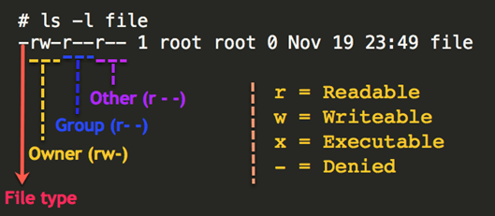
Vital Tech
Myanmar
File Permissions
There are three defined categories of users.
The categories are:
Owner - the owner of the file or application.
Others - All users with access to the system.
Group - The group that own the file or application.
There are three permissions for any file, directory or application program.
read - indicate that a given category of user can read a file.
write - indicates that a given category of user can write to a file.
execute – indicates that a given category of user can execute the file.
Vital Tech Myanmar IT Solution & Training. All Right Reserved © 2023

